Slide 1
What Is Metaverse?
By Ahmed Raza Shaikh

Slide 2
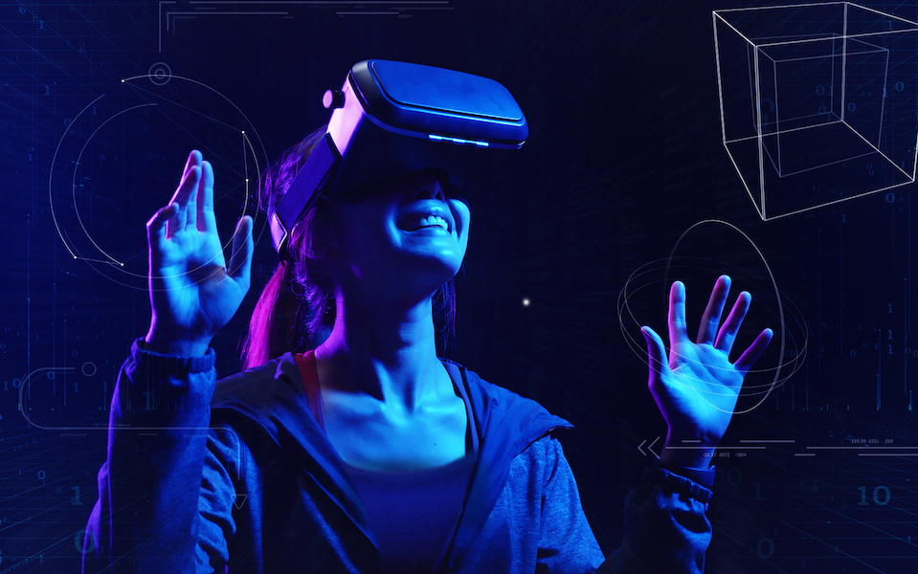
What Is Metaverse?
The actual definition of Metaverse is “A massively scaled and interoperable network of real time rendered 3D virtual worlds that can be experienced synchronously and persistently by an effectively unlimited number of users with an individual sense of presence, and with continuity of data, such as identity, history, entitlements, objects, communications, and payments.

Slide 3
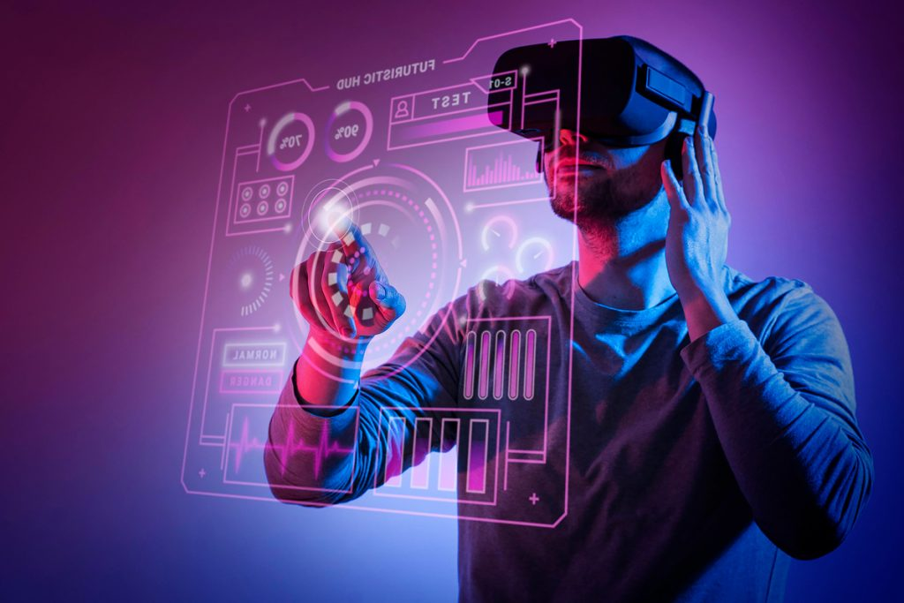
What Is Metaverse?
The term METAVERSE was originated by Neal Stephenson in his 1992 novel Snow Crash.
According to him, Metaverse was a persistent virtual world that reached, interacted with, and affected nearly every part of human existence
He also said that It was a virtual place where a pizza deliverer in the real world could be a talented swordsman with inside access to the hottest clubs
The idea of the Metaverse means an ever-growing share of our lives, labor, leisure, time, wealth, happiness, and relationships will be spent inside virtual worlds, rather than just extended or aided through digital devices and software.

Slide 4
What Is Metaverse?
Metaverse would be made up of Virtual Worlds(any computer-generated simulated environment which can be in immersive 3D, 3D, 2.5D, 2D, layered atop the “real world” via Augmented Reality, or purely text-based), 3D Environment(to make possible the transition of human culture and labor from the physical world to the digital one), Real-Time Rendering(process of generating a 2D or 3D object or environment using a computer program)

Slide 5
What Is Metaverse?
According to Microsoft:
Metaverse is a platform that turns the Entire world into an app canvas which could be augmented by cloud software and machine learning.
Microsoft own Metaverses like Minecraft, Microsoft Flight Simulator, and even the spacefaring first-person shooter Halo.
According to Mark Zuckerberg:
Metaverse is a platform of social experiences that connect individuals who live far apart.
An expansive, digitized communal space where users can mingle freely with brands and one another in ways that permit self-expression and spark joy.

Slide 6
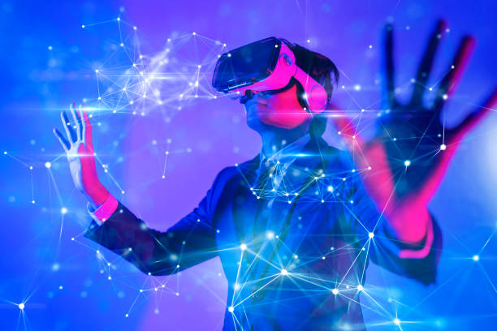
What Is Metaverse?
According to the head of investor relations at NetEase, a Chinese Gaming Giant,
The Metaverse is indeed the new buzzword everywhere today. But then, on the other hand, I think nobody has actually had firsthand experience in what it is. But at NetEase, we are technologically ready. We know how to accumulate the relevant know-how, the relevant skill sets when that day comes. So, I think when that day eventually comes, we’d probably be one of the fastest runners in the metaverse space.

Slide 7
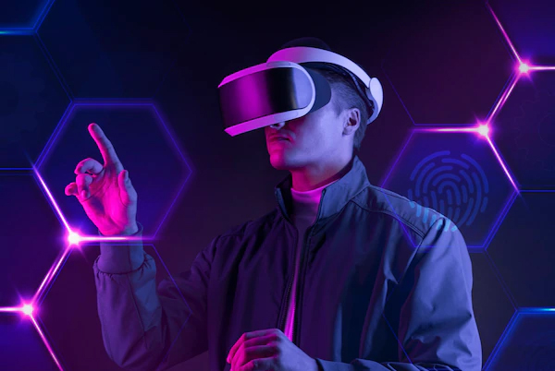
What Is Metaverse?
A common understanding of the Metaverse is a never-ending virtual world where everyone dresses up as comical avatars and competes in immersive VR games to win points, jumps into their favorite franchises, and acts out their most impossible fantasies

